Slide 1
Efficient Edge
A productivity platform
Presented By-
1. Shreya Bonde
2. Rutwik Chabuskar
3. Devayani Joshi
4. Soham Joshi

Slide 2
PROJECT DETAIL
Project Title | Efficient Edge
Technology | JS,NODE, EXPRESS, REACT MongoDB: 1.mongo 2.jwt
Project Difficulty Level | Medium
Programming Language Used | Java Script
Tools used | MERN stack

Slide 3
Objective
1. Increase Productivity:
Work Smarter, Not Harder: Make tasks easier by automating repetitive work and creating handy templates.
Manage Time Effectively: Use calendars and to-do lists to schedule tasks and track progress.

Slide 4
2. Decrease Procrastination
Track Your Progress: Keep an eye on how much you've done to stay motivated.
Set Achievable Goals: Break big tasks into smaller ones with clear deadlines and reminders.
3. Enhance Focus:
Take Breaks Wisely: Use timers to work in focused bursts followed by short breaks.
Block Out Distractions: Have a distraction-free mode that helps you stay on track without interruptions.
This platform aims to help you get more done by making work easier, keeping you motivated, and helping you stay focused.

Slide 5
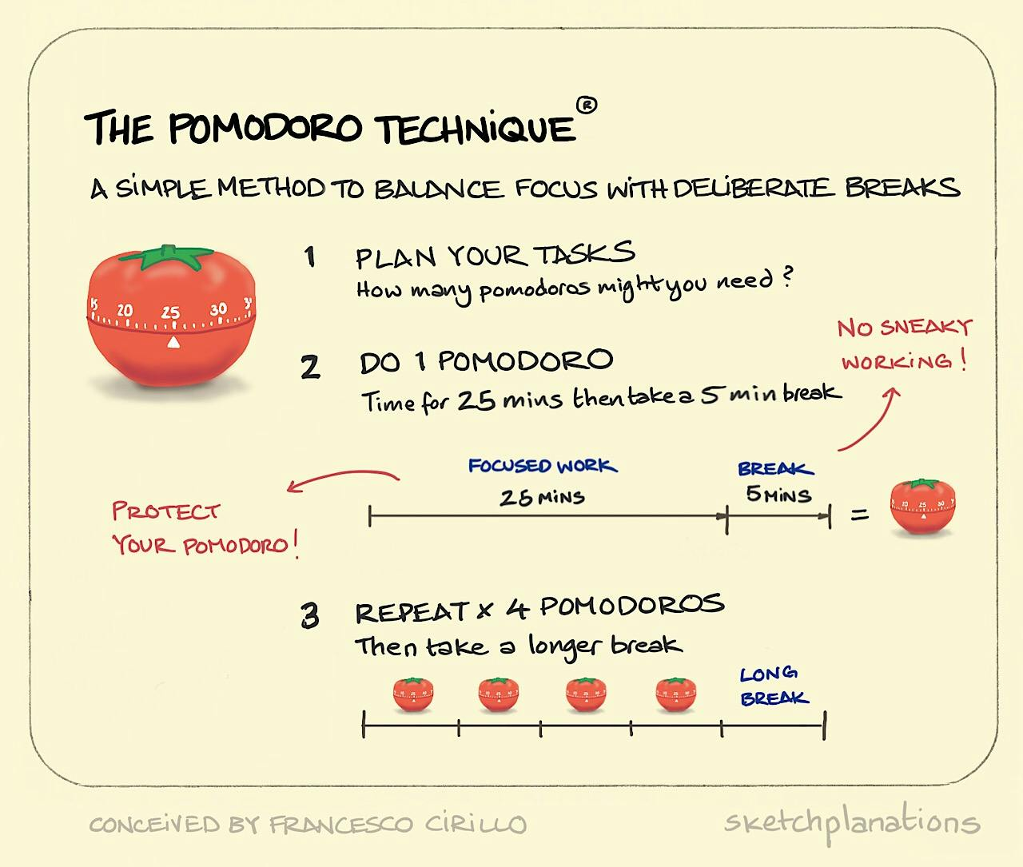

Slide 6
Problem Statement
Many people find it hard to manage time well, stay focused on tasks, and avoid procrastination. This leads to stress and lower productivity. Existing tools often don't make it easy to stay organized or keep track of progress. We need a platform that's user-friendly and combines automation, goal setting, progress tracking, and focus tools to help people work better, stay motivated, and get things done efficiently.

Slide 7
Architecture
Client-Side (Frontend):
  User Interface (UI): Developed using HTML, CSS, and JavaScript (JS) to create a responsive and intuitive interface. It includes components for Pomodoro timer controls, task lists, progress bars, and notifications.
  1. Frameworks/Libraries: Utilize frontend frameworks/libraries such as React.js for building dynamic and interactive UI components.
  2. Client-Side Scripting: JS handles timer logic, user interactions, and real-time updates of UI elements.

Slide 8
2. Server-Side (Backend):
  Application Logic: Built using Node.js with Express.js to handle backend logic, routing, and API endpoints.
  User Authentication: Implement JWT-based authentication for user registration, login, logout, and secure access to user-specific data.
  Pomodoro Timer Logic: Backend manages Pomodoro session states, timing intervals, session history, and task management functionalities.
  Database Interaction: Use MongoDB with Mongoose for storing and managing user profiles, task lists, Pomodoro session data, and user preferences/settings.

Slide 9
3. APIs (Application Programming Interfaces):
  Pomodoro Timer API: Expose RESTful APIs for starting, pausing, resetting Pomodoro timers, fetching task lists, saving progress, and generating notifications.
  User Authentication API: APIs handle authentication, user registration/login/logout, and manage authentication tokens (JWT) for secure API access.
4. Hosting and Deployment:
  Cloud Hosting: Deploy the website on a cloud platform like AWS, Google Cloud, or Azure for scalability, reliability, and easy deployment updates.
  Continuous Integration/Continuous Deployment (CI/CD): Use CI/CD pipelines to automate testing, building, and deploying new features or bug fixes.

Slide 10
5. Security:
  Authentication Middleware: Use middleware for verifying user sessions, permissions, and ensuring secure access to API endpoints.
  Input Validation/Sanitization: Implement input validation and sanitization to prevent common security vulnerabilities like SQL injection and cross-site scripting (XSS).
6. User Experience (UX) Enhancements:
  Responsive Design: Ensure the website is responsive and accessible across different devices (desktop, tablet, mobile) for a seamless user experience.
  Customizable Settings: Provide users with customizable settings for Pomodoro session duration, break length, notification preferences, and task categorization to tailor the experience to their needs.

Slide 11

Technologies Used
JavaScript (JS):
Definition: JavaScript is a programming language commonly used for interactive web development.
It runs on the client-side (in the user's browser) and allows for dynamic content, user interactivity, and manipulation of web page elements. JS is versatile and supports various frameworks and libraries for building web applications.

Slide 12
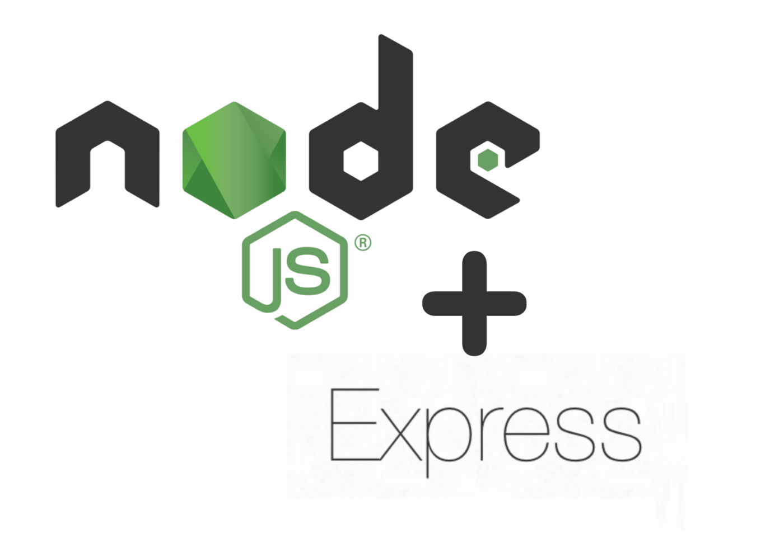
2. Node.js & Express:
Node.js Definition: Node.js is a runtime environment that allows developers to run JavaScript on the server-side. It is built on the V8 JavaScript engine provides features for server-side scripting, networking, and event-driven programming.
Express Definition:
Express.js is a minimalist web framework for Node.js that simplifies the process of building web applications and APIs. It provides routing, middleware support, and utilities for handling HTTP requests and responses.

Slide 13

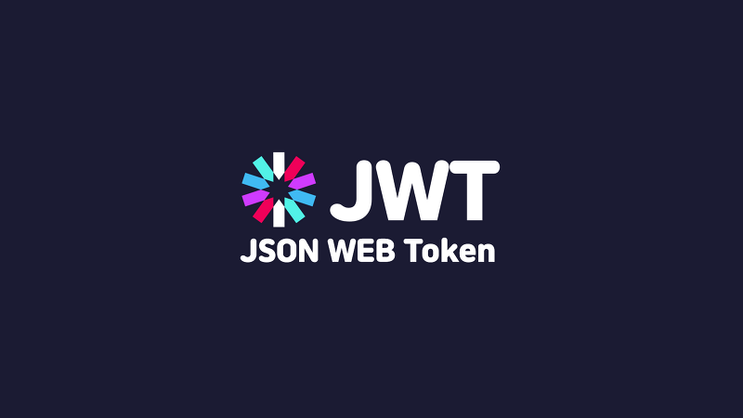
  3. Mongoose:
  Definition: Mongoose is an Object Data Modeling (ODM) library for Node.js and MongoDB. It provides a structured way to model data, define schemas, perform CRUD operations, and establish relationships between data entities.
4. JWT (JSON Web Tokens):
Definition: JSON Web Tokens (JWT) is a compact, URL-safe way of representing claims between two parties. It is commonly used for authentication and authorization in web applications. JWTs consist of three parts: a header, a payload (claims), and a signature. They are digitally signed to verify their authenticity and can carry information about the user's identity and permissions

Slide 14
Future Scope
Advanced Pomodoro Techniques: Include variations like Extended Pomodoro and customizable intervals.
Task Management: Prioritize :tasks, manage dependencies, and add sub-tasks for complex projects.
Collaboration: Enable sharing with team members, track team productivity, and provide analytics.
Integration: Connect with project management, calendar, and note-taking tools for seamless workflow.
Analytics: Offer insights on productivity trends, session effectiveness, and personalized recommendations.
Accessibility: Ensure compliance with accessibility standards and provide customization options.
Community Engagement: Create a platform for user interaction, workshops, and feedback collection.
Continuous Improvement: Gather user feedback, conduct surveys, and update the platform regularly.

Slide 15
Conclusion
In summary, our project has taught us crucial elements for creating a successful website:
Designing a user-friendly frontend with interactive features using JavaScript and frontend frameworks.
-Implementing a robust backend for business logic, data processing, and database management through server-side scripting and APIs.
Utilizing reliable hosting, deployment tools, and cloud services for scalability, reliability, and automation.
Ensuring security with SSL/TLS certificates, authentication mechanisms, and firewalls to protect user data.
Optimizing performance with CDNs for swift content delivery and a seamless user experience globally.

Slide 16
Thank You

